Slide 1
OSPF Routing
Chapter 5

Slide 2
Learning Outcomes
Explain the function of OSPFv2 and OSPFv3 Routing
Implement a network with OSPF routing

Slide 3
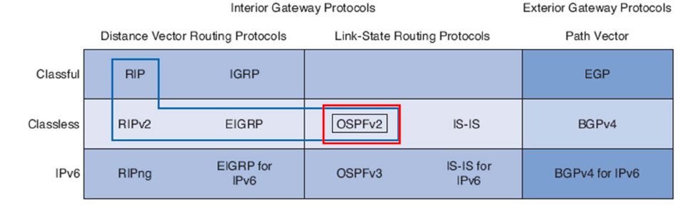
Introduction to OSPF
OSPF is a classless, link-state routing protocol
It is an open standard and inter-operate across multi vendor environments
It is known for it’s scalability.

Slide 4
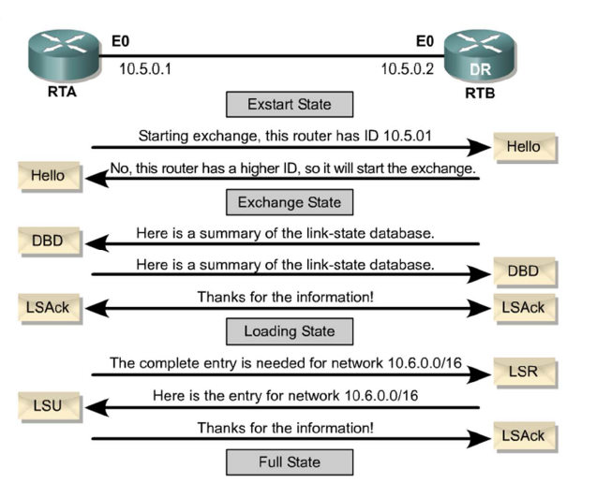
OSPF Packet Types
Five types of OSPF LSPs (link-state packets).
Hello: Used to establish and maintain adjacency.
DBD (Database Description): Abbreviated list of the sending router’s linkstate database.
LSR (Link-State Request) : Used by routers to request more information about any entry in the DBD.
LSU (Link-State Update): Link-state information.
LSAck (LSA Acknowledgment): Router sends a link-state (LSAck) to confirm receipt of the LSU.

Slide 5
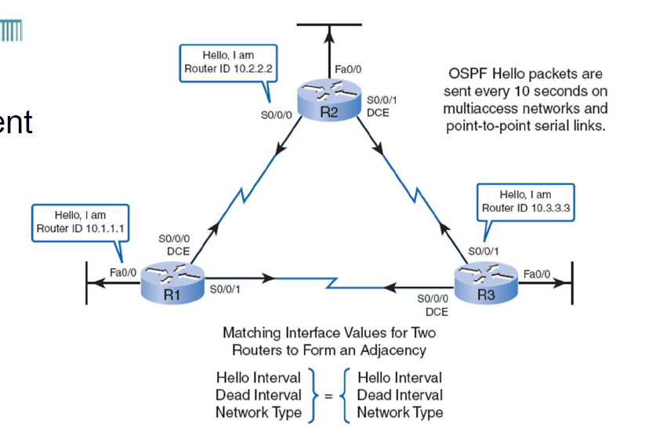
Hello Packet and Neighbour Establishment
Hello Packets are sent by OSPF enabled routers to discover their neighbours and establish adjacencies.
Only when the 3 parameters (Hello interval, Dead interval and Network Type) are agreed, the routers can become neighbours
Now the routers can exchange their DBD.
Full adjacency happens after both routers on a link have exchanged LSUs and have identical link state databases.

Slide 6
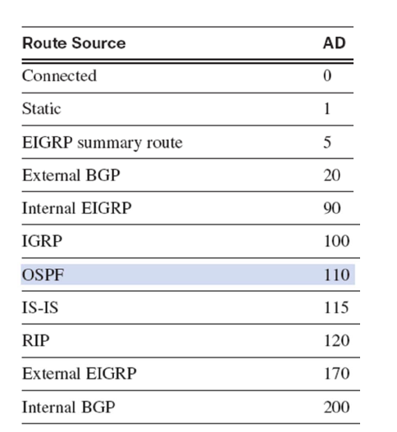
Administrative Distance
Administrative distance (AD) is the trustworthiness (or preference) of the route source.
OSPF has a default AD of 110.
So let’s say I want to reach destination 10.1.1.1
Both OSPF and Static routes on the router can
technically get me there. But which one will the
router choose?

Slide 7
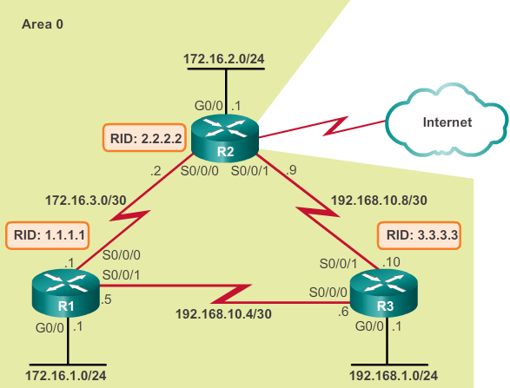
OSPFv2 Configuration
Let’s use this sample configuration
Every router has a Router ID
Every link has 2 IP Addresses
Every Router has 3 connected ports

Slide 8
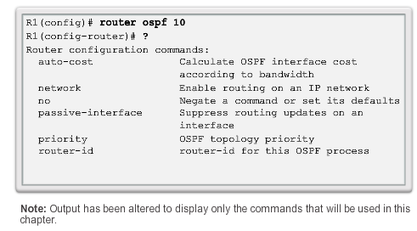
Enabling OSPFv2 Routing
R1(config)# router ospf [ process-id ]
This command enables OSPF on the router using process-id of 10 in this example
Note that process-id is of local significance only. It doesn’t have to be the same across all routers.

Slide 9
Router ID and Network statement
R1(config)#router ospf 10
R1(config-router)#router-id 1.1.1.1
A Router ID uniquely identifies a router. It will be useful especially later in IPv6 configurations.
R1(config-router)#network 172.16.3.0 255.255.255.252 area 0
Identify all the router’s connected networks (you can do this by issuing a “show ip route“)
Then use the network statement to advertise to other routers what R1 is connected to.
If you do not advertise a route using the network statement, the other routers will not know that R1 has that connection to the network.
Area 0 is the backbone area

Slide 10
OSPF Passive Interface
This is a kind of interface on which OSPF LSAs(Link State Advertisements) will not be sent out. LSAs are only useful to other OSPF Enabled routers, so why waste bandwidth by sending them on link which connect switches and PCs?
R1(config-router)# passive-interface g0/0
Inside the routing configuration, you can define any interface to be a passive interface. This interface will then not receive any LSAs.

Slide 11
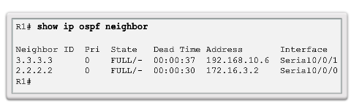
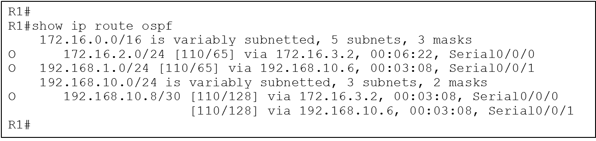
Verifying OSPFv2 operation
#show ip ospf neighbors
Verify that the router has formed an adjacency with its neighbouring routers.
#show ip route
Verify if the router is learning remote routes

Slide 12
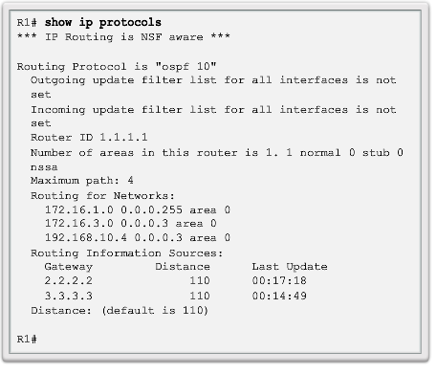
Verify OSPFv2 Operation
#show ip protocols
Process ID
Router ID
Networks advertised
Neighbour routers
l

Slide 13
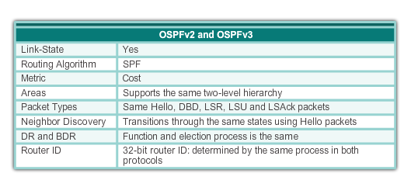
Similarities between OSPFv3 and OSPFv2

Slide 14
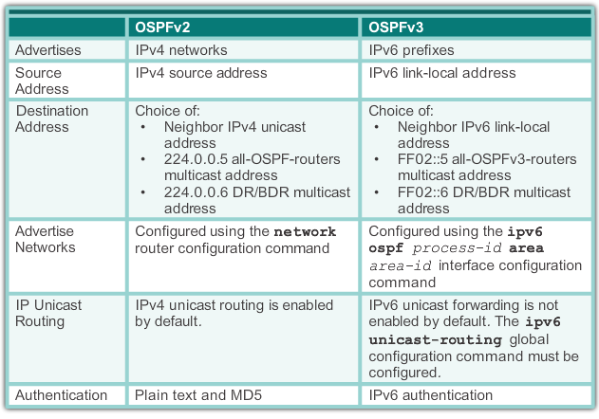
Differences between OSPFv2 and OSPFv3

Slide 15
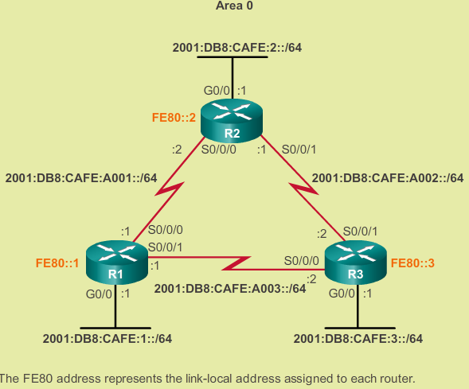
Configuring IPv6 Interface
R1(config)#ipv6 unicast-routing
To activate IPv6 on the router
R1(config)#int s0/0/0
R1(config-if)#ipv6 add 2001:db8:café:a001::1/64
To configure global IPv6 Address on the interface.
R1(config-if)#ipv6 addr fe80::1 link-local
To configure link local address on interface (no need prefix. Default to /10). Link local addresses are only used to ping connected routers.

Slide 16
Configuring OSPFv3
R1(config)# ipv6 router ospf 10
R1(config-router)#router-id 1.1.1.1
Configure OSPFv3 process with ID 10 and configure a router ID
R1(config-if)#ipv6 ospf 10 area 0
Each participating interface must be individually configured with the above command to advertise their network in OSPF process. The command above replaces “network” command in OSPFv2.
Further reading at: https://www.cisco.com/c/en/us/support/docs/ip/ip-version-6-ipv6/113328-ipv6-lla.html

Slide 17
Verifying OSPFv3
#Show ipv6 protocols
Shows info about configured ipv6 protocols such as process ID, router ID, Area.
#Show ipv6 ospf neighbor
Shows established OSPF neighbour adjacencies
#Show ipv6 ospf interface
Shows all of protocol information and hello intervals
#show ipv6 route
Shows the IPv Routing table

Slide 18
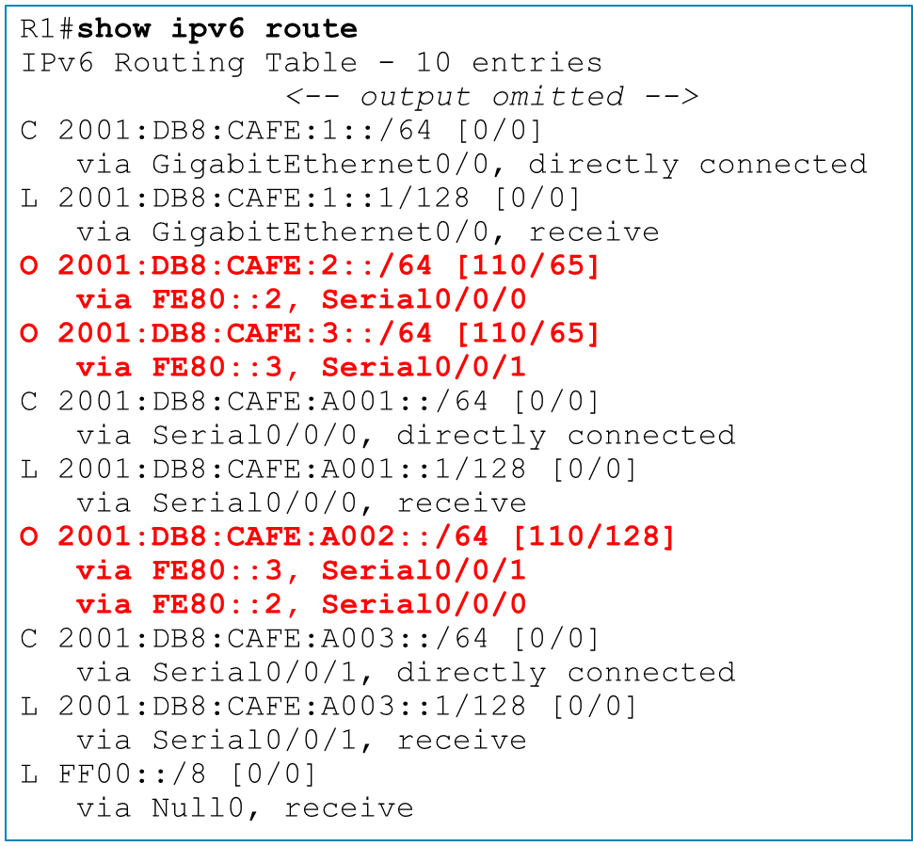
IPv6 Routing table
Router R1 has learned 3 remote networks via OSPF
Notice that they learn the global ipv6 destination routes through the link local interfaces

Slide 19
THE END

